Slide 1
P I E “Why Writers Write”
Created by Rachel Remenschneider | Shared on www.SmekensEducation.com

Slide 2
3 Modes of writing:
Persuade
Inform
Entertain
Created by Rachel Remenschneider | Shared on www.SmekensEducation.com

Slide 3
Persuade
When writers write a persuasive piece they…
may try to, influence, motivate, argue, convince, evaluate, or express a feeling about an opinion through a writing piece.
Created by Rachel Remenschneider | Shared on www.SmekensEducation.com

Slide 4
Birthday Party Invite
Why is this a persuasive piece?
Created by Rachel Remenschneider | Shared on www.SmekensEducation.com

Slide 5
Magazine Advertisement
WHY PERSUASIVE?
Created by Rachel Remenschneider | Shared on www.SmekensEducation.com

Slide 6
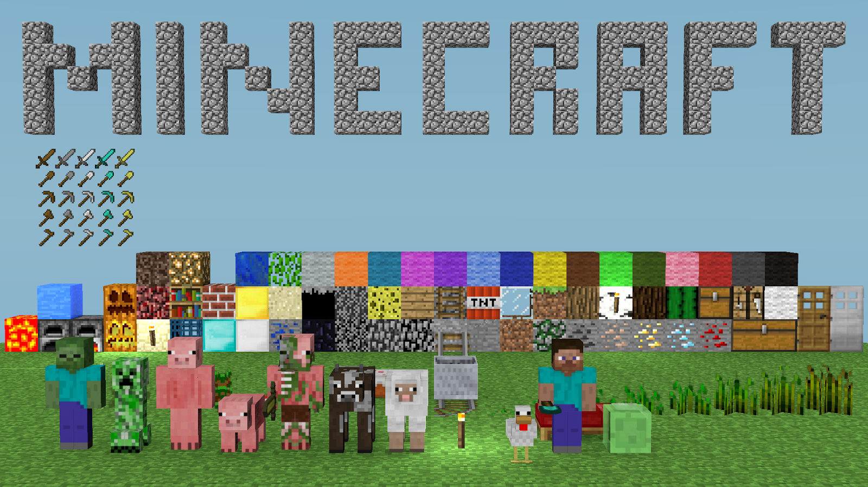
Video Game Review
Created by Rachel Remenschneider | Shared on www.SmekensEducation.com

Slide 7
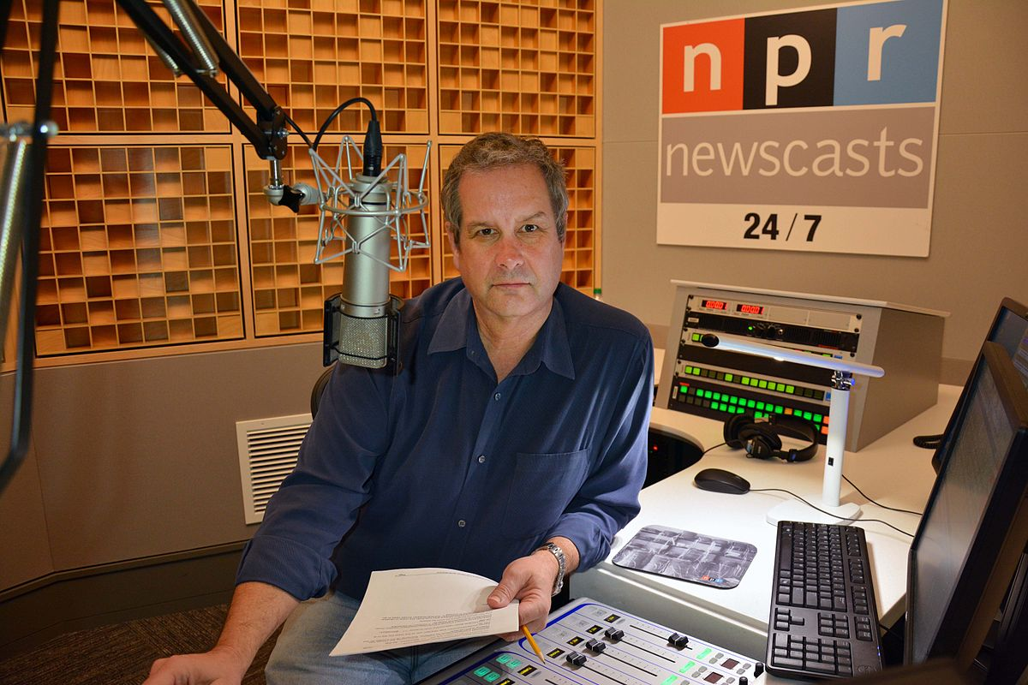
Inform
When writers write an informative piece they…
try to explain, teach clarify, define, or demonstrate understanding.
Created by Rachel Remenschneider | Shared on www.SmekensEducation.com

Slide 8
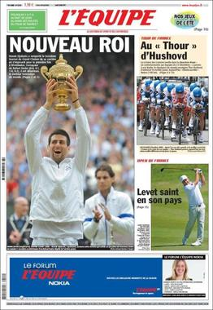
Sports article
Informative? Why?
Created by Rachel Remenschneider | Shared on www.SmekensEducation.com

Slide 9
Youtube video tutorial
Created by Rachel Remenschneider | Shared on www.SmekensEducation.com

Slide 10
SCHOOL SUPPLY LIST
Why is this an informative piece?
Created by Rachel Remenschneider | Shared on www.SmekensEducation.com

Slide 11
Entertain
convey a story
share an experience
make us laugh
Created by Rachel Remenschneider | Shared on www.SmekensEducation.com

Slide 12
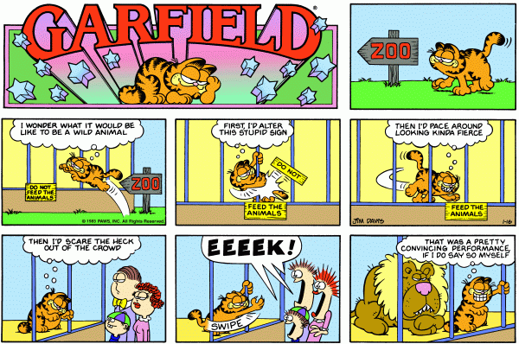
Newspaper comics
Created by Rachel Remenschneider | Shared on www.SmekensEducation.com

Slide 13
SONG LYRICS
Created by Rachel Remenschneider | Shared on www.SmekensEducation.com

Slide 14
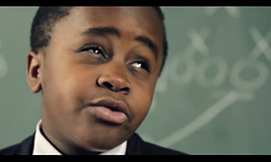
SOCIAL MEDIA POST
Created by Rachel Remenschneider | Shared on www.SmekensEducation.com

Slide 15
You will write to
You will write to
You will write to
persuade
inform
entertain
Created by Rachel Remenschneider | Shared on www.SmekensEducation.com

Slide 16
now
go be
writers
let’s
Created by Rachel Remenschneider | Shared on www.SmekensEducation.com

Slide 17
CHALLENGE….IF YOU ACCEPT?
LIST TOPICS THAT FIT IN EACH MODE FOR WRITING
PERSUASIVE, INFORMATIVE, ENTERTAIN
Created by Rachel Remenschneider | Shared on www.SmekensEducation.com

Slide 18
Writing Time: When you think, you are done….
You Have Only Just Begun
Created by Rachel Remenschneider | Shared on www.SmekensEducation.com

